Slide 1
Phishing Awareness Training
Recognizing and Avoiding Phishing Attacks

Slide 2
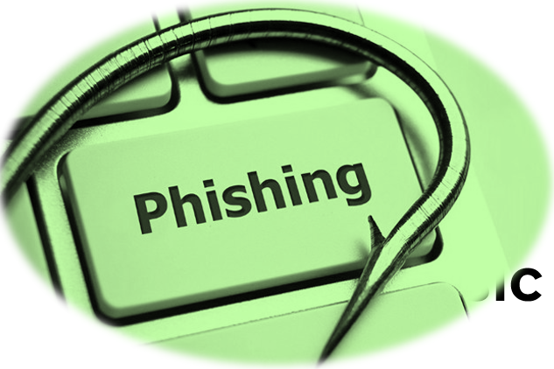
Agenda
Introduction
What is Phishing?
Common Phishing Tactics
Recognizing Phishing Emails
How Phishing Websites Work
Avoiding Phishing Attacks
Social Engineering Tactics
Reporting Phishing Attempts
Conclusion

Slide 3
What is Phishing?
Phishing is a type of cyberattack where attackers impersonate legitimate organizations or individuals to steal personal information.
This can include login credentials, financial information, or personal identification data.

Slide 4
Common Phishing Tactics
1. **Email Spoofing**: Attackers send fake emails from trusted sources.
2. **Fake Websites**: Phishing websites resemble real ones to steal login information.
3. **Social Engineering**: Attackers manipulate users into revealing sensitive information.
4. **Urgent Requests**: Phishing messages often create a sense of urgency to trick victims.

Slide 5
Recognizing Phishing Emails
Look out for these signs in phishing emails:
- Suspicious sender email address
- Generic greeting (e.g., 'Dear Customer')
- Unusual links or attachments
- Spelling and grammar mistakes
- Unsolicited requests for sensitive information
- Threats or urgent calls to action

Slide 6
How Phishing Websites Work
Phishing websites appear similar to legitimate sites but have slight differences.
Look for these red flags:
- URL doesn't match the official website
- HTTPS is missing or the certificate is invalid
- Poor website design or broken links
- Requests for personal or financial data

Slide 7
Avoiding Phishing Attacks
**Verify email sources**: Always check the sender's email address.
**Hover over links**: Hover your mouse over links to check if they point to legitimate websites.
**Don't open suspicious attachments**: Avoid clicking on unexpected attachments or links.
**Use multi-factor authentication**: Add an extra layer of security to your accounts.
**Report suspicious emails**: Always report phishing attempts to your IT department.

Slide 8
Social Engineering Tactics
Phishing is a form of social engineering. Attackers manipulate emotions or trust to gain access to confidential information.
Examples include:
- Impersonating a boss or coworker
- Creating a sense of urgency
- Offering fake prizes or rewards
- Exploiting current events or news

Slide 9
Reporting Phishing Attempts
If you receive a suspicious email or encounter a phishing attempt:
- Do not engage with the sender or click any links.
- Report the incident to your IT or security team.
- Provide the details of the suspicious email or website.
- Delete the message or close the website immediately.

Slide 10
Conclusion
Phishing attacks are becoming more sophisticated, but with awareness and caution, you can protect yourself and your organization. Remember to verify sources, avoid clicking on suspicious links, and report phishing attempts to stay safe.

